Slide 1
Factors in Unemployment During COVID-19 Pandemic
Tim Hintz, Dan Valenzuela

Slide 2




Business Problem
Environmental
Features
Demographic
Features
Labor
Features
Problem: The coronavirus pandemic and efforts to curtail it have impacted households’ employment status and economic well-being in a variety of ways.
Solution: Create a classification model to understand which factors contribute most to unemployment.
Impact: Using these factors, policymakers can target which populations will need aid the most.
Classifying Employment Status

Slide 3







Data Overview
Demographic
Labor
Environmental
Sources
COVID-19
Increases
Marital
Status
Hours
Worked
Description
~3900 adult heads of household employed as of April 2020
~70 features of each individual created
State Politics

Slide 4
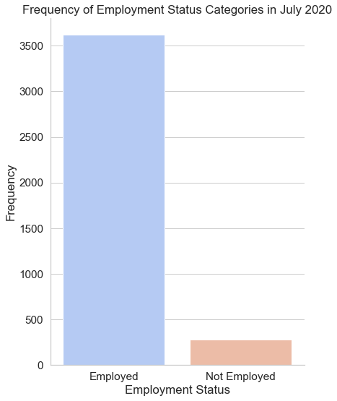
Status of Employment in July 2020
About 300 people in our population became unemployed or left the workforce from April to July
Expected Outcomes:
Workers in hospitality industry hit hardest
Older workers would drop out of employment due to COVID concerns
Political alignment of state would have an impact

Slide 5
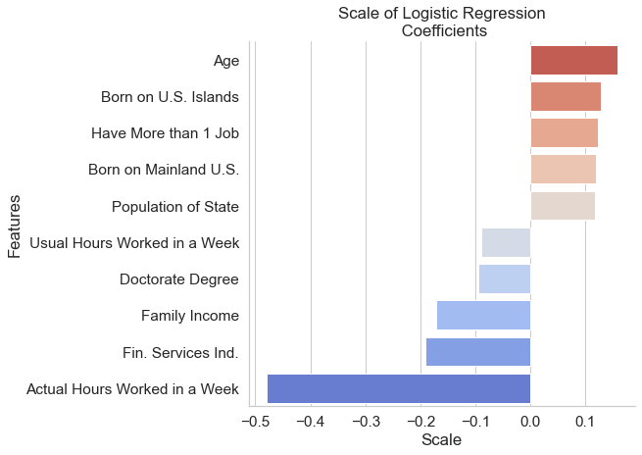
Findings - Factors in Unemployment
The more you work and the more money you make, the more likely you are to be employed
Unexpectedly, hospitality industry did not appear in the top 10 most important factors

Slide 6
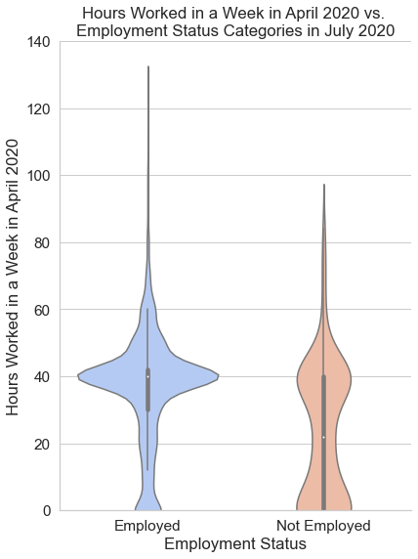
The distribution of people who lost their jobs had two clusters, one for full time and one for part time.
People who were still employed in July worked longer hours and tended to not have two jobs

Slide 7
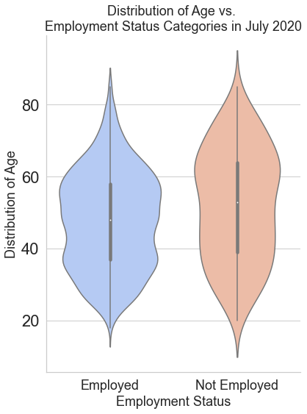
Normally distributed given population is heads of household
Above age 60 more people went out of the workforce than those below 40

Slide 8
Recommendations
Next Steps for Improving Model
We should be searching for high risk areas based on the proportion of part-time employees, total household income and the average age.
Look for more granular geographic data
Find a “control” dataset to compare our results
Use historical data (Dot com bubble burst, housing crisis)

Slide 9
Contact Info & Credits
Image Credits
DinoLabs
Flat SVG Designs
Tim Hintz
tjhintz@gmail.com
GitHub.com/SlimHintz
Dan Valenzuela
dan@danvalenzuela.com
GitHub.com/danvalen1

